Slide 1
Deep Cross-Domain Model for Visual Data Processing
Prof. Yi Fang
yfang@nyu.edu
Spring, 2016

Slide 2
Announcement
Project 3 for joint and consistent segmentation has been released
A bonus mini project for cross-domain retrieval (depth-shape) will be released by next week
Grades for project 1 and 2 and bonus projects will be released by the end of the week
Final project update presentation on April 28th
Intermediate Report of Final project will be due on April 23rd. Please refer to project description for the details.

Slide 3
Overview of this course
3D Computer Vision
3D Shape Analysis
Retrieval
Registration
Segmentation
Traditional 3D Processing Techniques
Data-driven Learning 3D Processing Techniques
Final Projects in Data Driven 3D Shape Analysis
Notes:
So far, we have covered the basic componments in 3D shape analysis that includes retrieval, registration and segementation

Slide 4
Today’s Content
Visual Data in Different Domains
Visual Feature Extraction
Deep Cross-domain Model

Slide 5
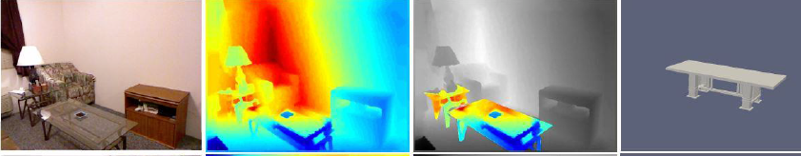
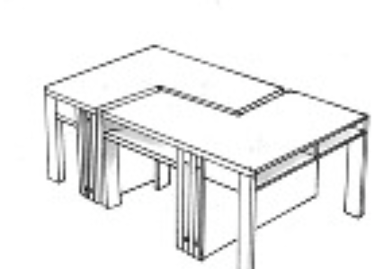
Visual Data in Different Domains
Image
Depth-Image
Depth-Image
3D Shape
Sketch

Slide 6
Image
A digital image is a numeric representation of (normally binary) a two-dimensional image.
Depending on whether the image resolution is fixed, it may be of vector or raster type.
By itself, the term "digital image" usually refers to raster images or bitmapped images.

Slide 7
Sketch
Freehand sketches/drawings are a natural,
intuitive, convenient yet efficient way for humans
to visually convey and communicate ideas and
information effectively.

Slide 8
Depth Image
In 3D computer graphics a depth map is an image or image
channel that contains information relating to the distance
of the surfaces of scene objects from a viewpoint.

Slide 9
3D Shape
A polygon mesh is a collection of vertices, edges and faces
that defines the shape of a polyhedral object in 3D computer graphics and solid modeling. The faces usually consist of triangles, quadrilaterals, or other simple convex polygons, since this simplifies rendering, but may also be composed of more general concave polygons, or polygons with holes.

Slide 10
Today’s Content
Visual Data in Different Domains
Visual Feature Extraction
Deep Cross-domain Model

Slide 11
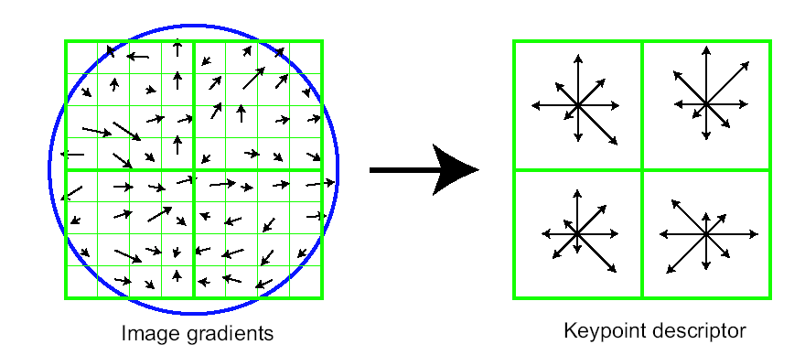
Lowe’s Keypoint Descriptor (shown with 2 X 2 descriptors over 8 X 8)
In experiments, 4x4 arrays of 8 bin histogram is used,
a total of 128 features for one keypoint

Slide 12
Lowe’s Keypoint Descriptor
use the normalized region about the keypoint
compute gradient magnitude and orientation at each point in the region
weight them by a Gaussian window overlaid on the circle
create an orientation histogram over the 4 X 4 subregions of the window
4 X 4 descriptors over 16 X 16 sample array were used in practice. 4 X 4 times 8 directions gives a vector of 128 values.
...

Slide 13
Sparse coding Spatial Pyramid Matching
Extract local SIFT features from the depth image (N*128 matrix)
Divide the image into 4*4 blocks, and perform local sparse coding on SIFT features within each block.
Project local sparse features onto a local dictionary and perform max pooling to obtain a global feature for an image block (if the dictionary size is 1024, the dimension of a global feature that represents the corresponding image block should be equal to 1024).
Concatenate global features of different image blocks to form the image descriptor (take the 3-scale example, there are 16 blocks at the bottom scale, 4 blocks at the middle scale and 1 block at the top scale, which result in (16+4+1)*1024=21504 dimensional descriptor for the image)

Slide 14
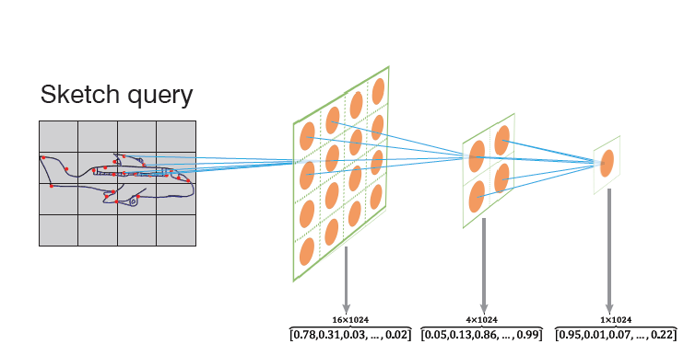
Sparse coding Spatial Pyramid Matching
Calculating ScSPM features for sketch images follows the same order as calculating ScSPM features for depth images.
The major difference between sketch images and depth images is the former is composed of lines, such that the majority of gradients equal to zero when computing SIFT features.
There is no the best features for sketches so far. ScSPM is one fairly good option.

Slide 15
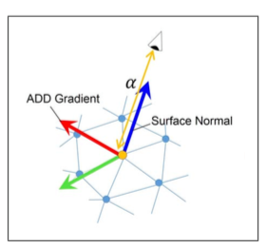
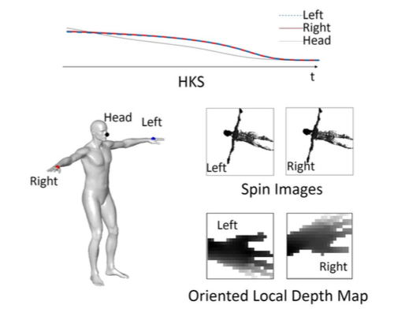
3D Depth SIFT

Slide 16
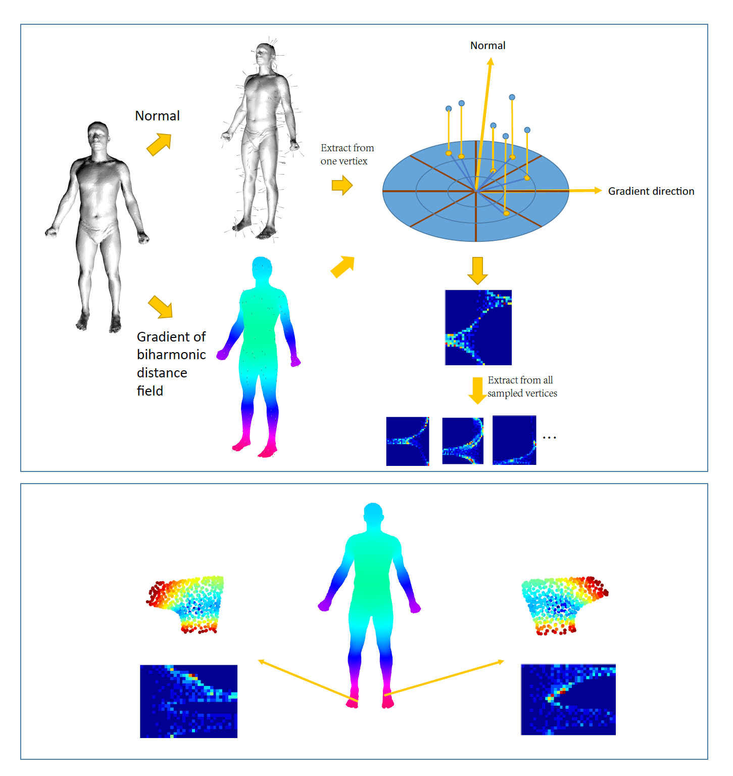
3D Biharmonic Descriptor

Slide 17
Today’s Content
Visual Data in Different Domains
Visual Feature Extraction
Deep Cross-domain Model

Slide 18
Deep Cross-Domain Model
Sketch - Shape Retrieval
Depth Image - Shape Retrieval
Image – Shape Joint Embedding Analysis

Slide 19
Sketch-Shape Retrieval
Introduction and motivations
Category-specific neural networks
Cross-domain neural networks
Experimental results

Slide 20
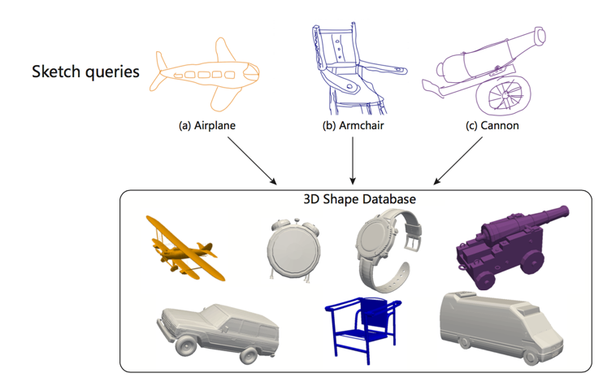
Task

Slide 21
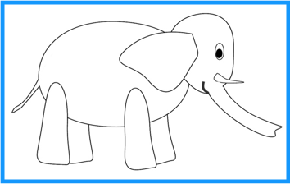
Introduction
Human freehand sketch is a succinct, convenient and efficient way to visually record and
present human’s ideas.
While sketches mainly convey abstract descriptions of objects, 3D shapes, on the other
hand, contain the majority information that are required for industrial productions.
Sketch based 3D shape retrieval will simplify the process of product design.

Slide 22
Motivations
Statistical investigation (Gunn, 1982) suggests that 80% of design work can benefit from
directly reusing or modifying an existing design;
Instead of manually transforming the draft design into digital forms, a product prototype
can be obtained by directly reusing or modifying a desired 3D shape selected from a pool
of retrieved 3D shapes based on the input draft.
Challenges
There does not exist a recognized representation for sketch data;
Establishing the matches from the sketch domain to the 3D shape domain or vice versa is
difficult;
Many previous approaches that use 2D rendered projection images for representing 3D
shapes suffer from the view variance and deformation problems.

Slide 23
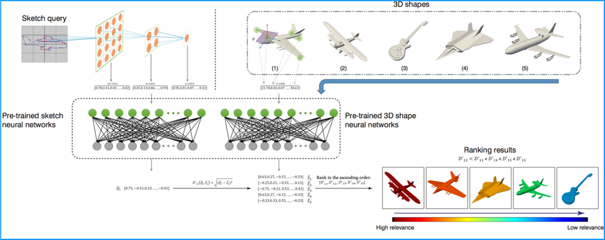
Pipeline

Slide 24
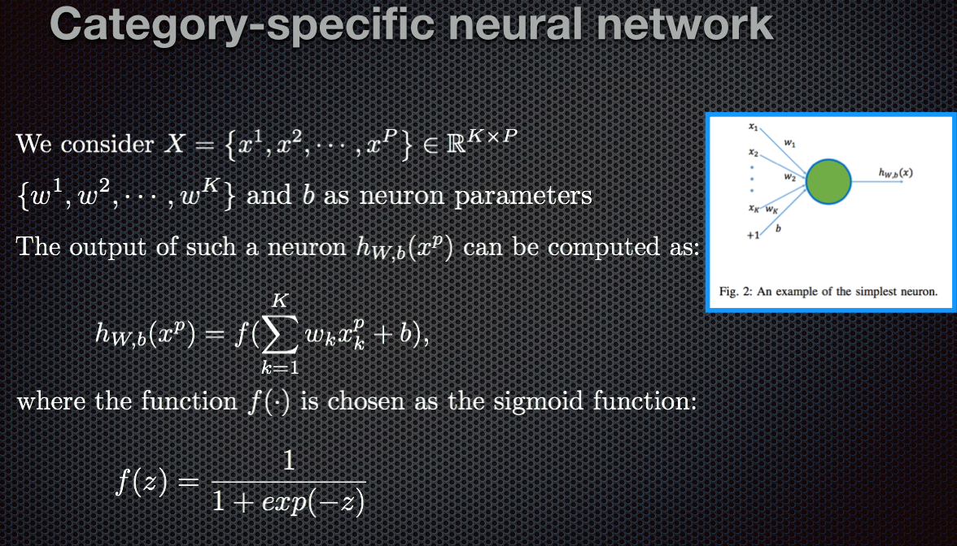

Slide 25
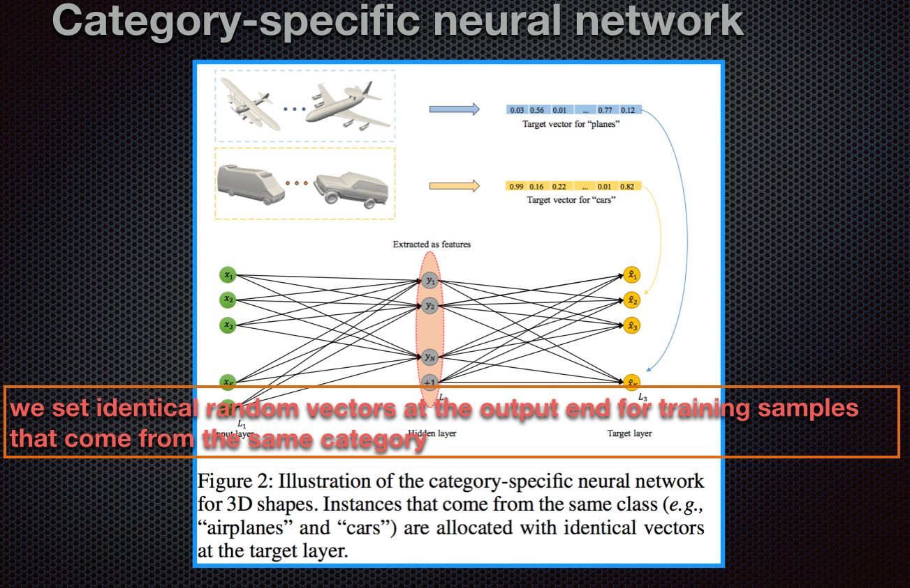

Slide 26
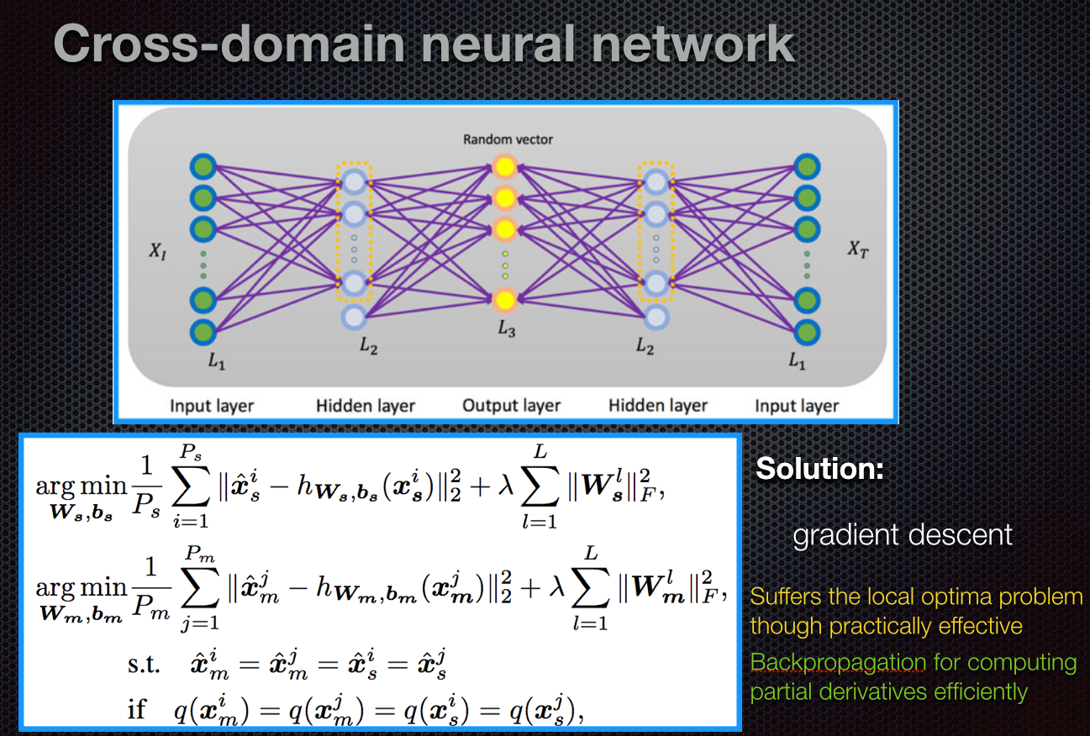

Slide 27
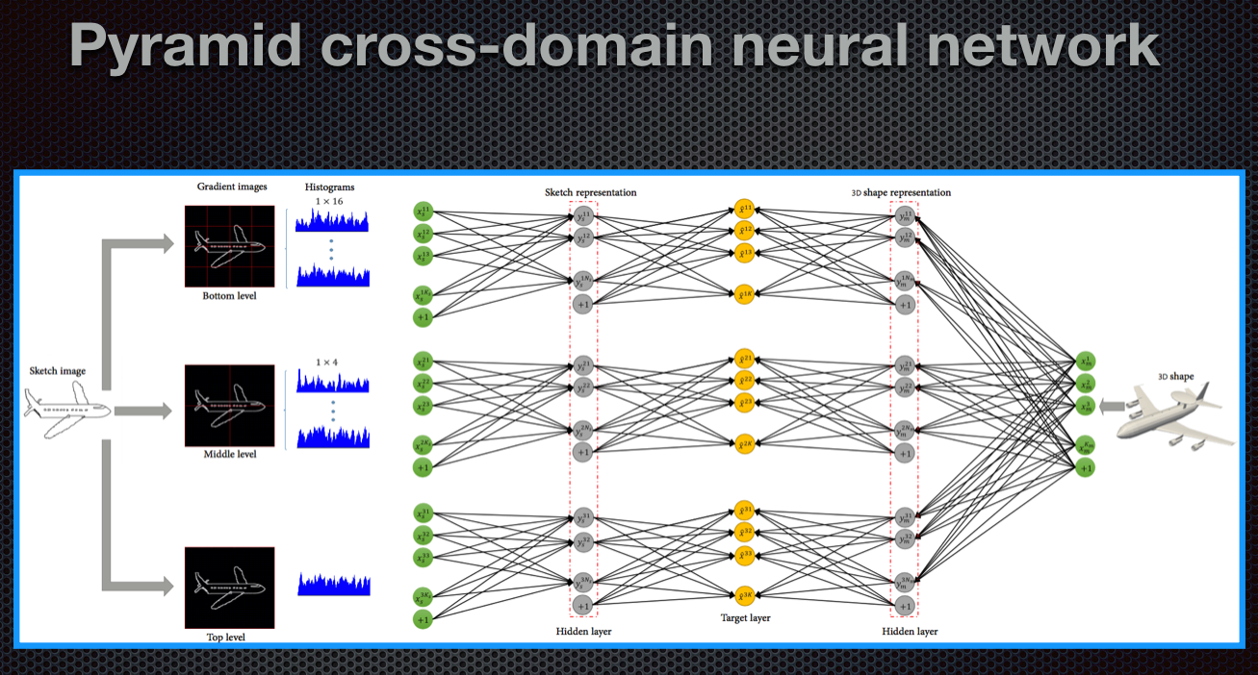

Slide 28
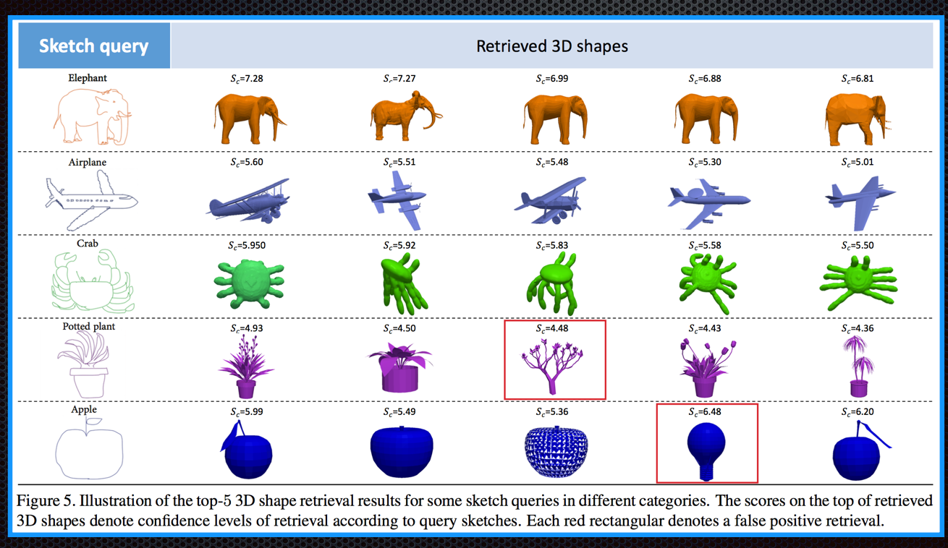
Experimental Result

Slide 29
Depth Image – Shape Retrieval

Slide 30
Outline
Depth Image-based 3D Model Retrieval
Pairwise Neural Network
Metric Learning Network
Experimental Result

Slide 31
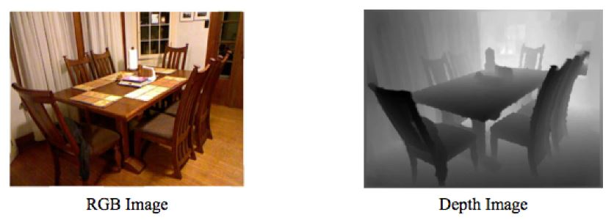
Depth Image-based 3D Model Retrieval
Depth Image -- an image or image channel that contains information relating to the distance of the surfaces of scene objects from a viewpoint ¹ .
Nearer surfaces are darker; further surfaces are lighter.

Slide 32
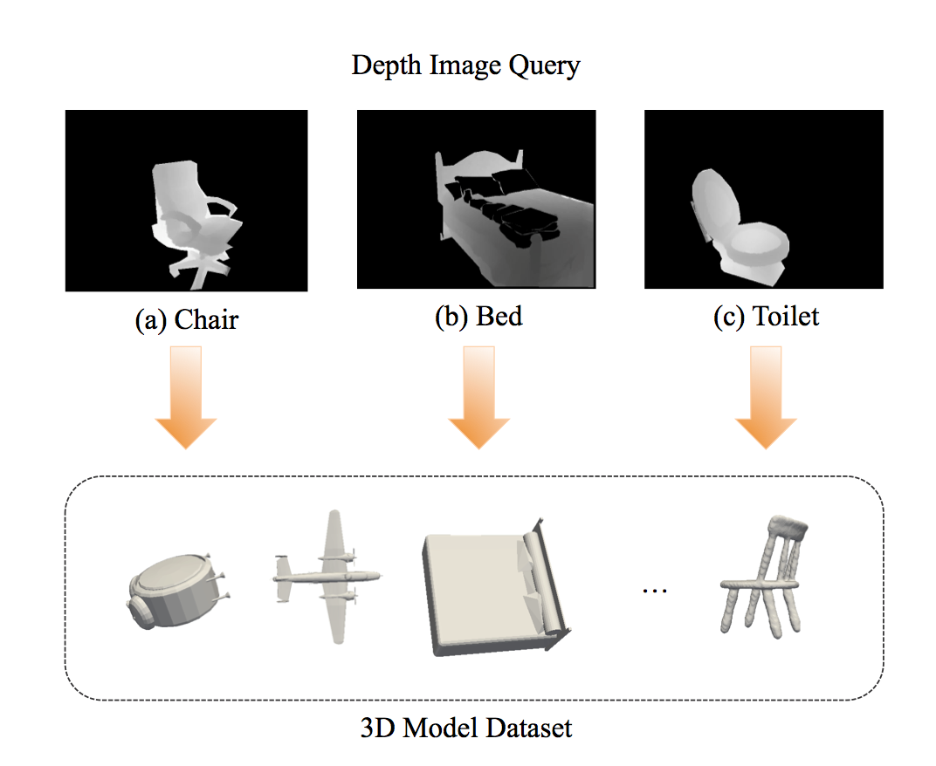
Depth Image-based 3D Model Retrieval
Depth Image-based 3D Model Retrieval
Take depth image as queries
Aim to get some 3D models from dataset, which are relevant to the queries

Slide 33
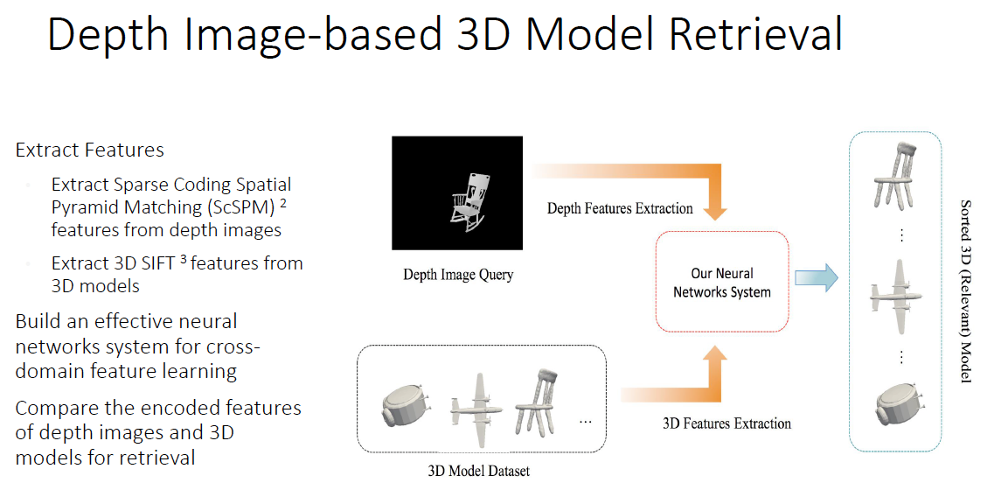

Slide 34
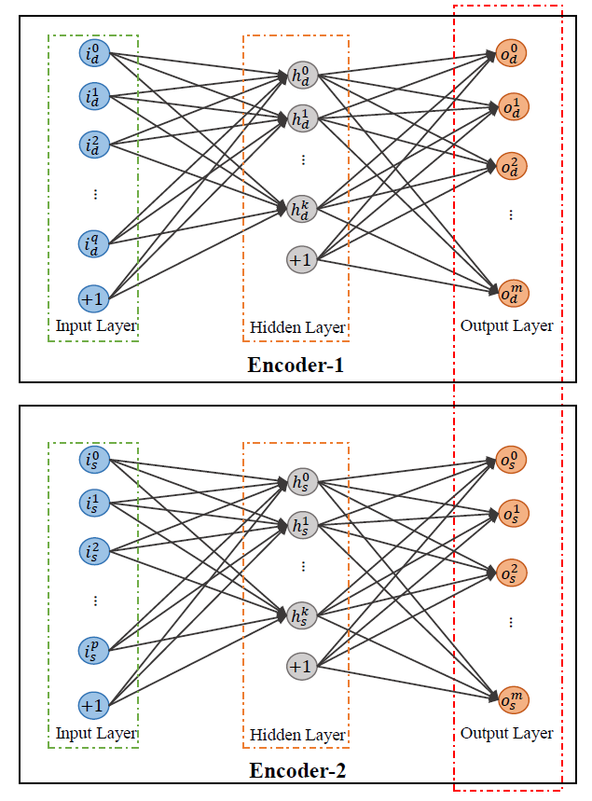
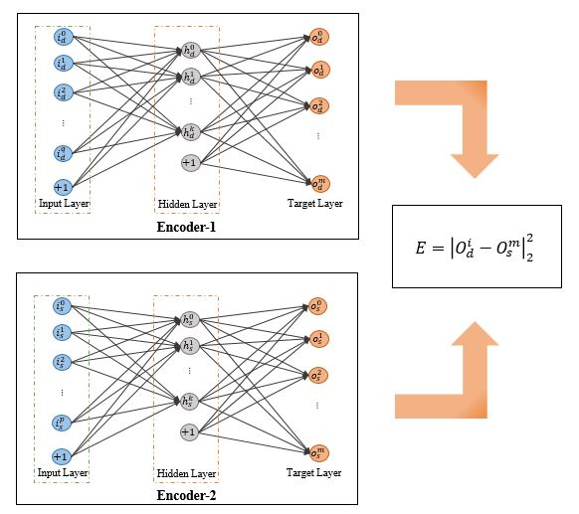
How to build an effective neural network system
Pairwise Neural Network ⁶
Metric Learning Network

Slide 35
Pairwise Neural Network
Independently optimize two discriminative neural networks while connecting both networks at their target layers

Slide 36
Pairwise Neural Network
Independently optimize two discriminative neural networks while connecting both networks at their target layers
Exploit two 3-layer neural networks based on depth features (ScSPM) and 3D model features (LD-SIFT) respectively

Slide 37
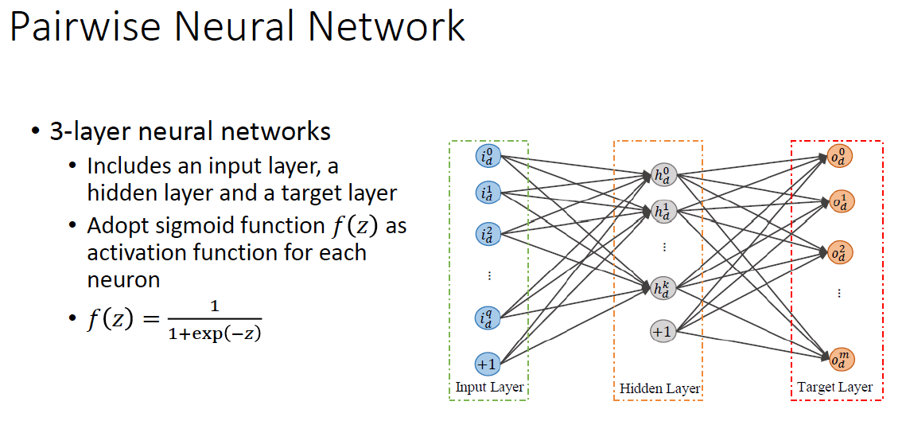

Slide 38
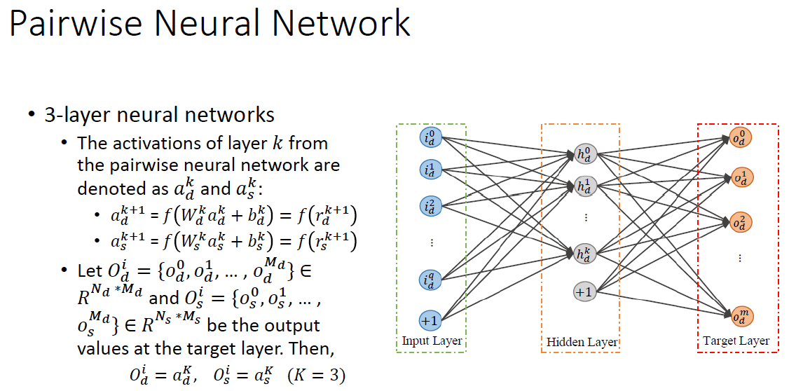
Notes:
Here, we denote the activations/output of layer k from the pairwise neural network as $a_{d}^{k}$ and $a_{s}^{k}$. $a_{d}^{k+1}$ = $f\left(W_{d}^{k}a_{d}^{k}+b_{d}^{k}\right) , a_{s}^{k+1}$ = $f\left(W_{s}^{k}a_{s}^{k}+b_{s}^{k}\right).$ Let $O_{d}^{i}$ and $O_{s}^{i}$ be the output values at the target layer. Then, we can get the equation: $O_{d}^{i}=a_{d}^{K}$, $O_{s}^{i}=a_{s}^{K}$ $(K=3)$

Slide 39
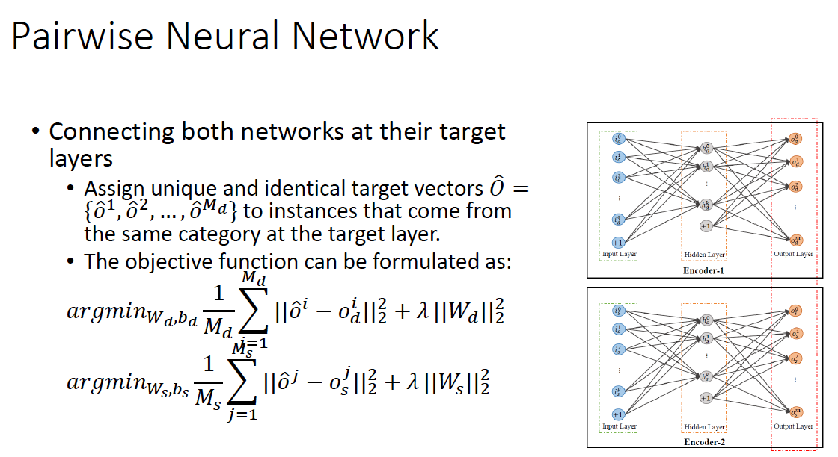

Slide 40
Pairwise Neural Network
Independently optimize two discriminative neural networks while connecting both networks at their target layers
Exploit two 3-layer neural networks based on depth features (ScSPM) and 3D model features (LD-SIFT) respectively
Assign unique and identical values at the target layers for data of the same class
Apply popular backpropagation to optimize each term in the objective function
Once the neural networks are trained, the outputs of the hidden layer are discriminative and used as the representations when depth features and 3D model features pass through the networks
Notes:
After the objective functions are formulated, we apply popular back-propagation to optimize each term in the objective function. Once the neural networks are trained, the outputs of the hidden layer are discriminative and used as the representations when depth features and 3D model features pass through the networks.

Slide 41
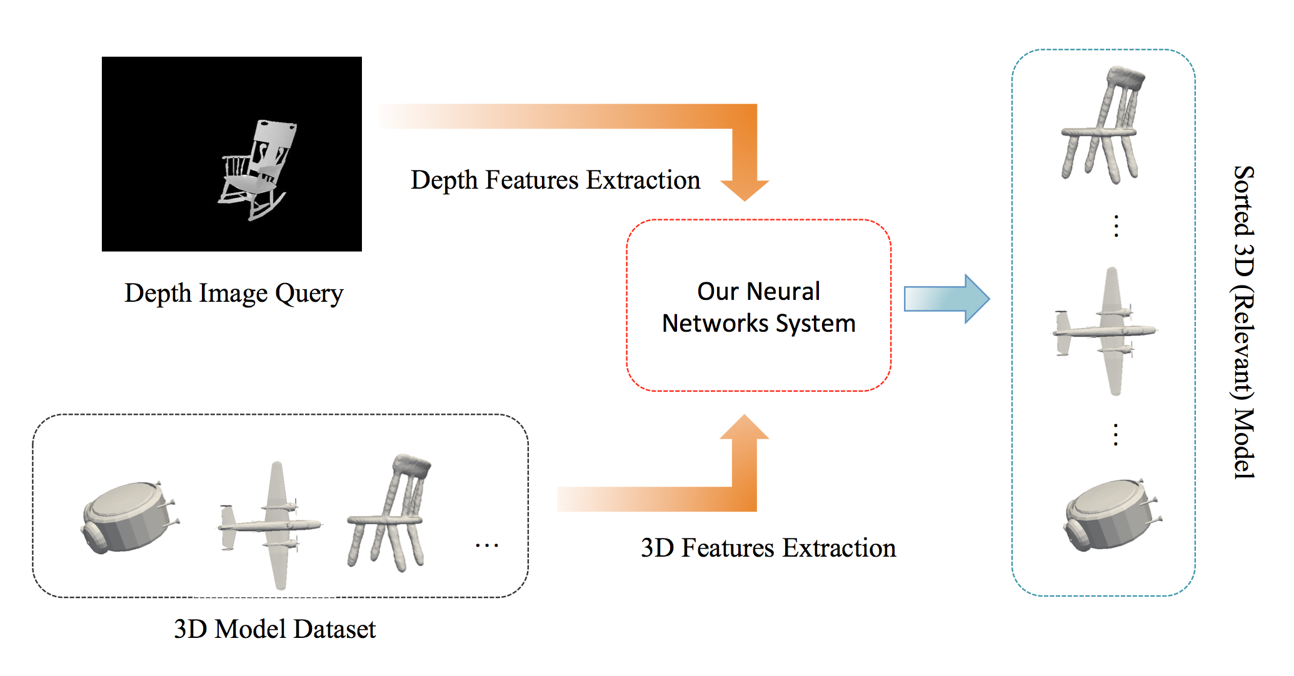
Pairwise Neural Network
Notes:
It means that for any given depth image query, we take the extracted features as input for our neural network system. After that, we take the hidden layer value as the representations for depth image and 3D models and compare them to retrieve 3D models. In general, if the object in depth image query is in the same category with the 3D models, they should have much more similar representation.

Slide 42
Pairwise Neural Network
The structure is novel, but performance is not very outstanding
Metric Learning Network

Slide 43
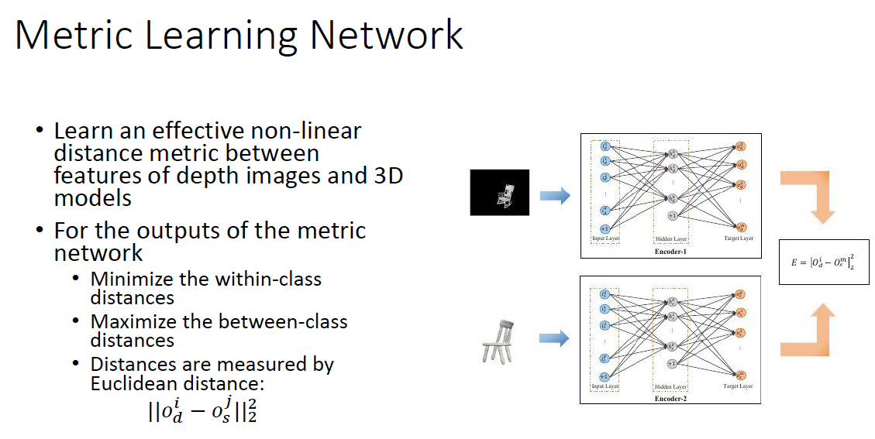

Slide 44
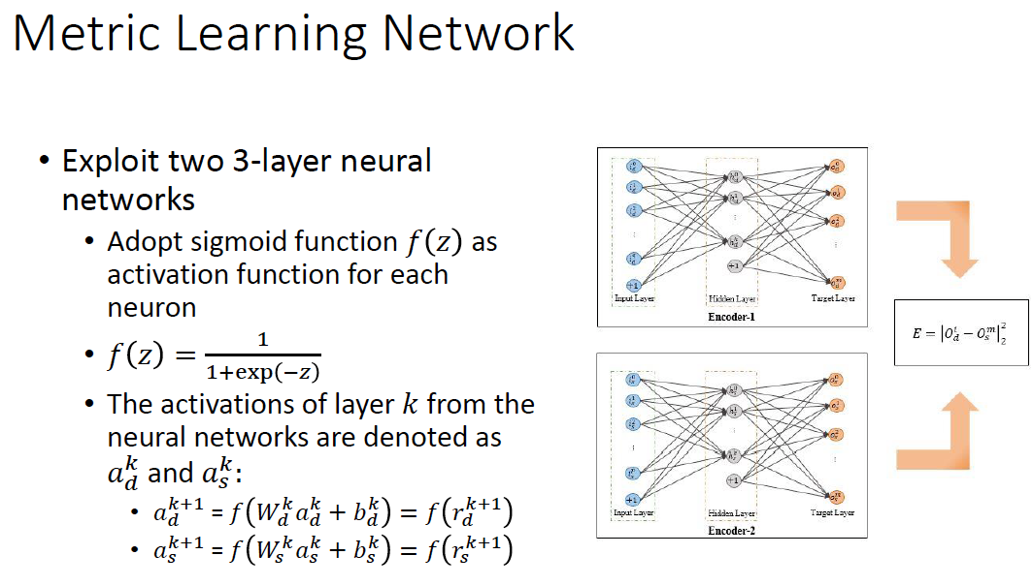

Slide 45
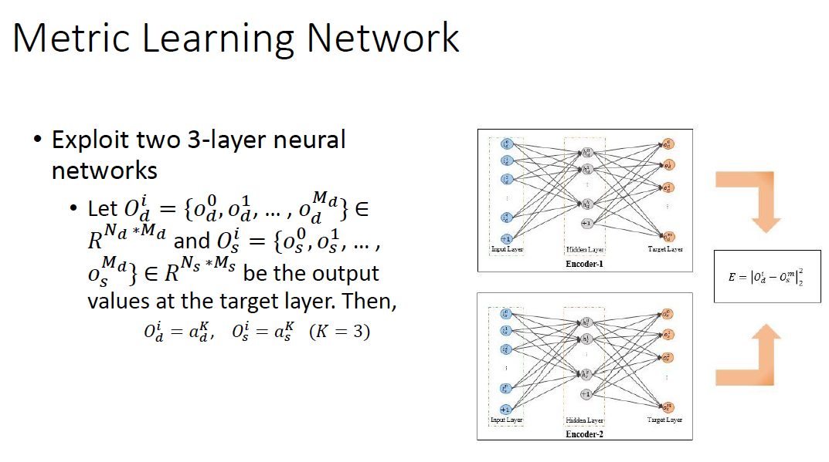

Slide 46
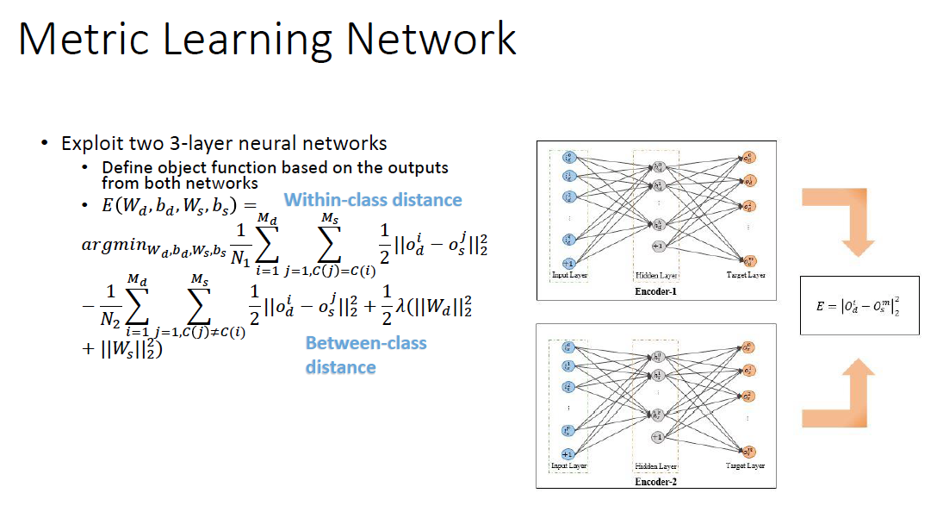

Slide 47
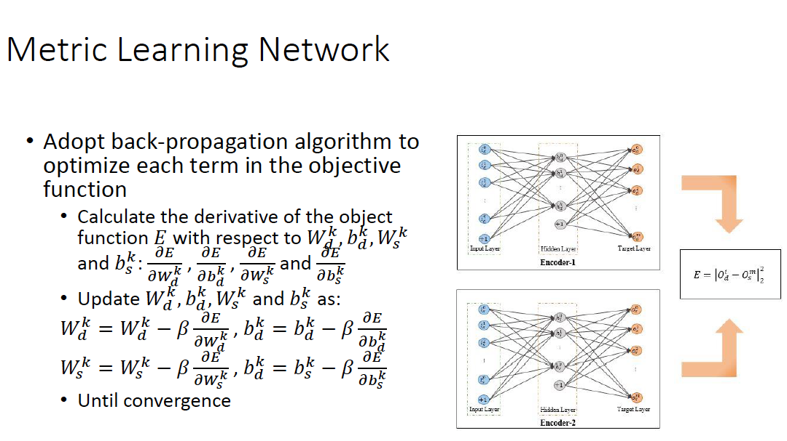
Notes:
To optimize each term in objective function, we adopt back-propagation algorithm. Firstly, we calculate the derivative of the object function E with respect to $W_{d}^{k},b_{d}^{k},W_{s}^{k}$ and $b_{s}^{k}$., which are the parameters of the neural networks. ($\frac{∂E}{∂W_{d}^{k}}$: partial derivative of a function E with respect to $W_{d}^{k}$).
After that, we update $W_{d}^{k},b_{d}^{k},W_{s}^{k}$ and $b_{s}^{k}$ following the below equations. For example, $W_{d}^{k}$ equals to $W_{d}^{k}$ minus beta times the partial derivative of a function E with respect to $W_{d}^{k}$.
We keep updating the parameters until convergence.

Slide 48
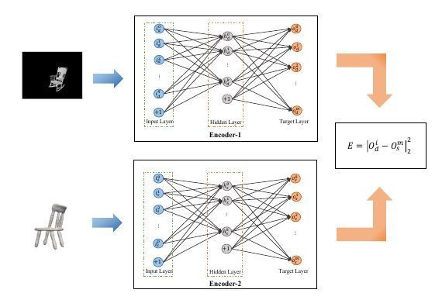
Metric Learning Network
Once the neural networks are trained, the outputs of the Target layer are used as the encoded features for depth images and 3D models.
Retrieve relevant 3D models based on the encoded features

Slide 49
Pairwise Neural Network VS Metric Learning Network
For Pairwise Neural Network
Assign identical target value for data from same category and train two neural network independently
Consider within-class difference
Once trained, use output value of the Hidden layer as representation
For Metric Learning Network
Define object function based on both output values from the target layer and train two neural network dependently
Take within-class difference and between-class difference into consideration
Once trained, use output value of the Target layer as representation

Slide 50
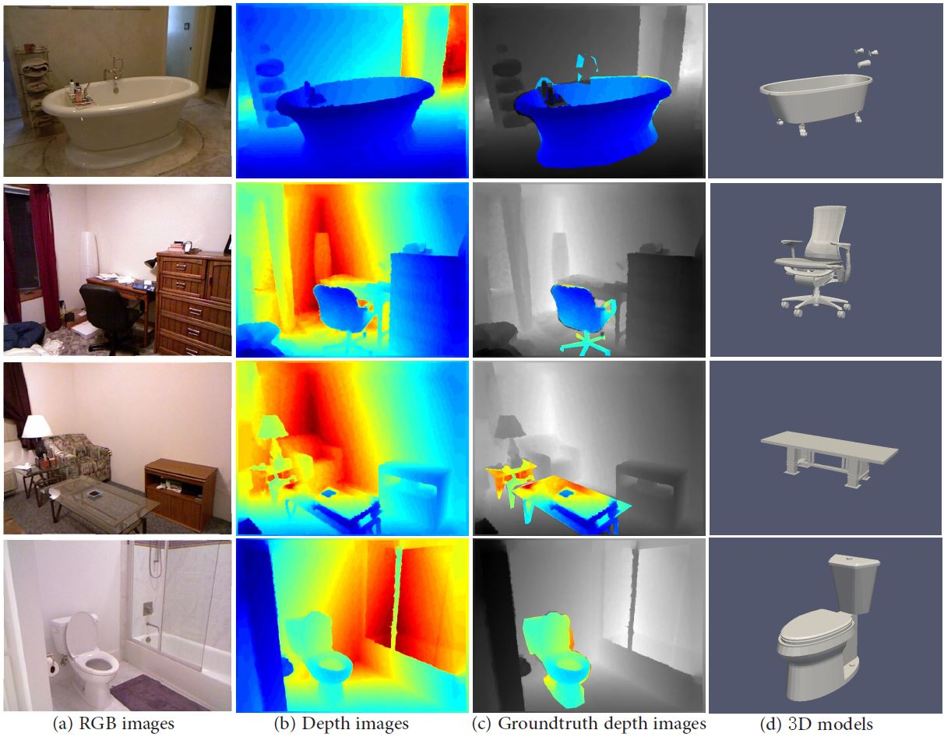
Experimental Result
NYU Depth V2 dataset ⁵ (Depth image dataset): contains frames of video sequences in a variety of indoor scenes, from where objects in depth images are extracted as queries in our experiments.
3D model dataset: constructed by selecting 3D models in corresponding categories from the large-scale extended SHREC 2014 benchmark ⁴

Slide 51
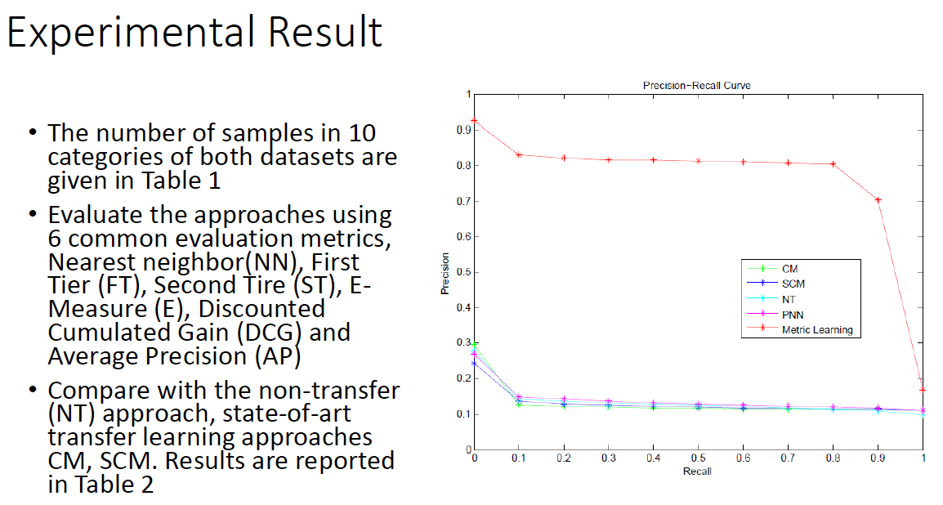

Slide 52
Deep Model for Image-Shape Joint Embedding
Note: The following slides about the image and shape embedding are referred to
https://shapenet.cs.stanford.edu/projects/JointEmbedding/

Slide 53
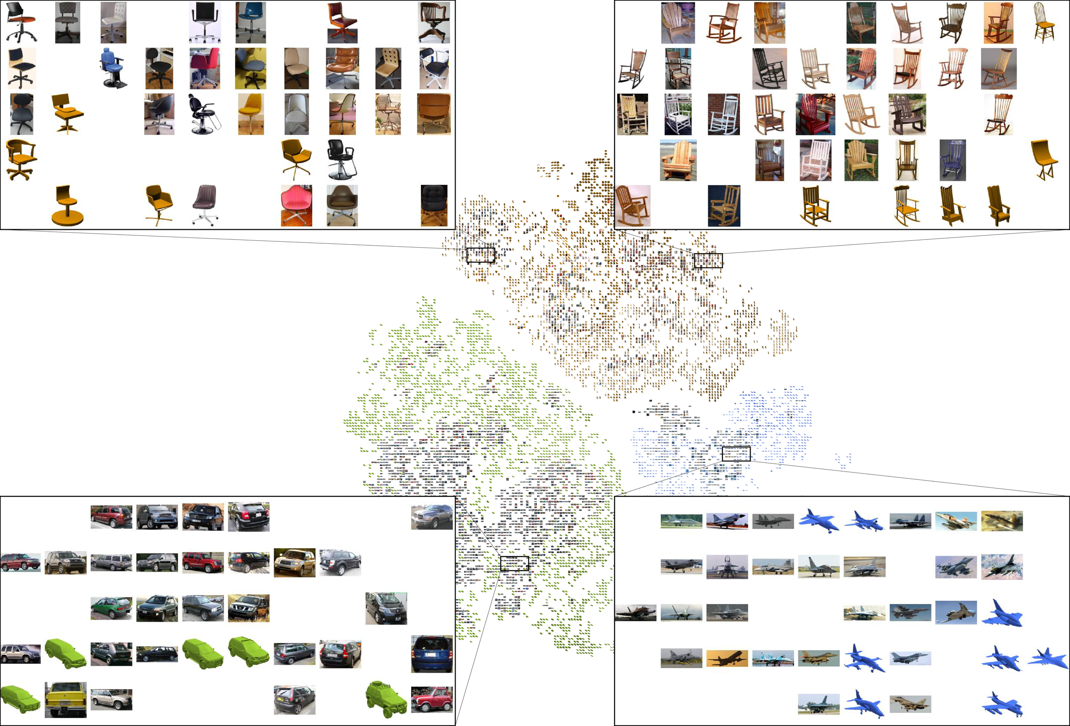
Task:

Slide 54
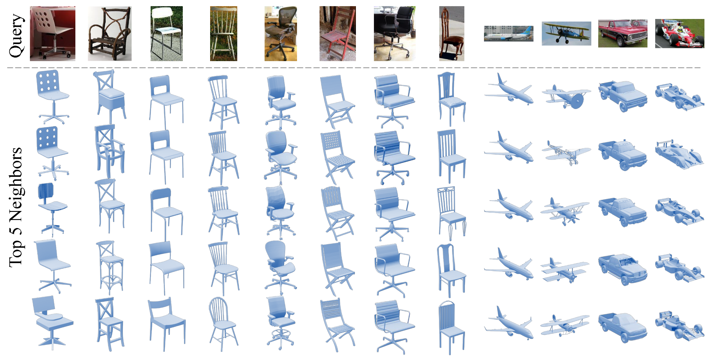
Image based Shape Retrieval

Slide 55
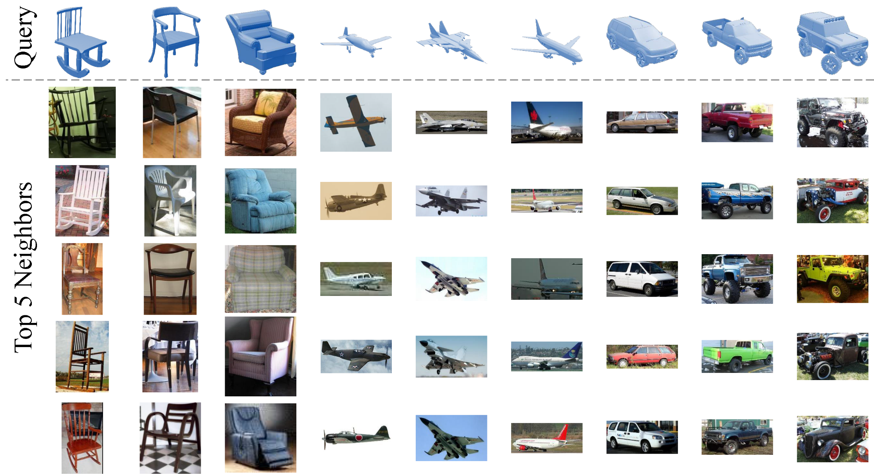
Shape based Image Retrieval

Slide 56
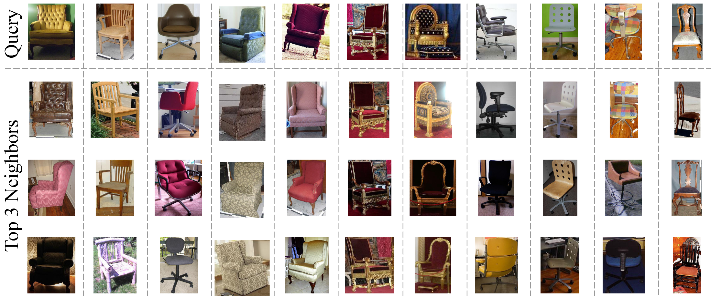
Cross-View Image Retrieval

Slide 57
Pipeline of Joint embedding
Embedding Space
Training
Image
Shape
Deep Neural Network

Slide 58
Main Steps:
3D Shape Descriptor Extractor
Manifold learning for 3D Shape Embedding
Deep neural network for mapping image to the
embedded space

Slide 59
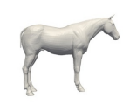
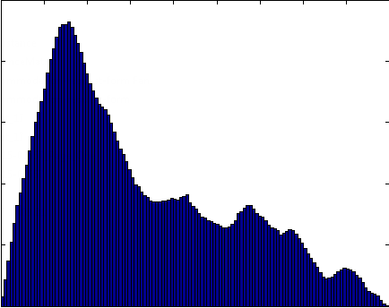
3D Shape Descriptor Extraction

Slide 60
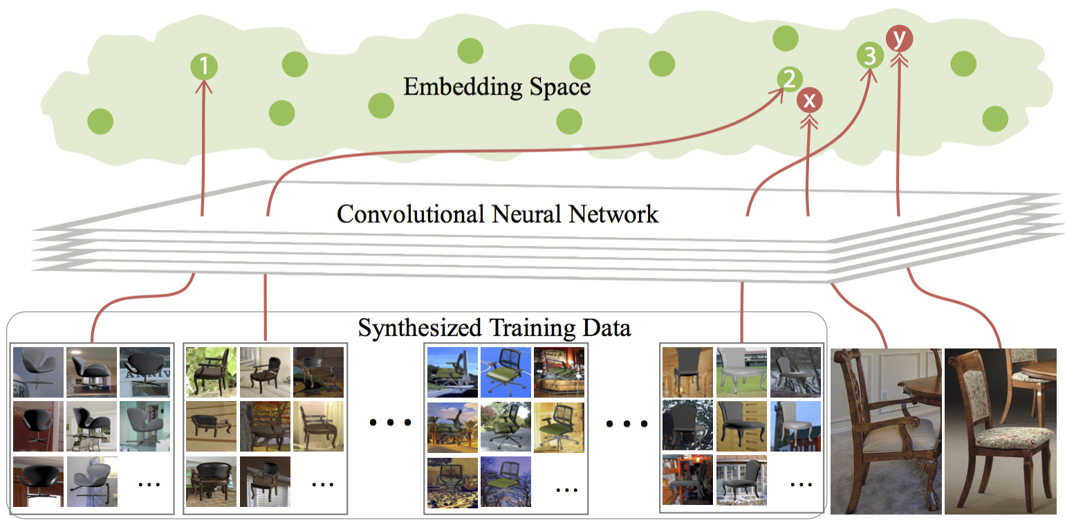
Manifold Learning

Slide 61
Deep Neural Network for joint embedding
Input: Pre-label image-(high-dimension points in embedding space)
Task: Learn a function that maps image to the embedding spaec

Slide 62
Announcement
Project 3 for joint and consistent segmentation has been released
A bonus mini project for cross-domain retrieval (depth-shape) will be released by next week
Grades for project 1 and 2 and bonus projects will be released by the end of the week
Final project update presentation on April 28th
Intermediate Report of Final project will be due on April 23rd. Please refer to project description for the details.

